Slide 1
Open MRS – DSS Coding & Alerts
CSC868 – Group 1

Slide 2
Group 1 Members
Robert Bierman
Kay Choi
Steven Gimeno
Jason Lum
Ying Kit Ng
Bianca Uy
Victor Woeltjen

Slide 3
Introduction and Overview
Physicians need not only a repository of information but also assistance in efficiently processing that information.
Decision support systems help analyze data in a relevant fashion
By creating a “rule” based DSS where physicians themselves (and others) can write these rules in a simplified manner allows effective use of DSS
Integrated into OpenMRS to allow access to patient data and simplified messaging in the unified system

Slide 4
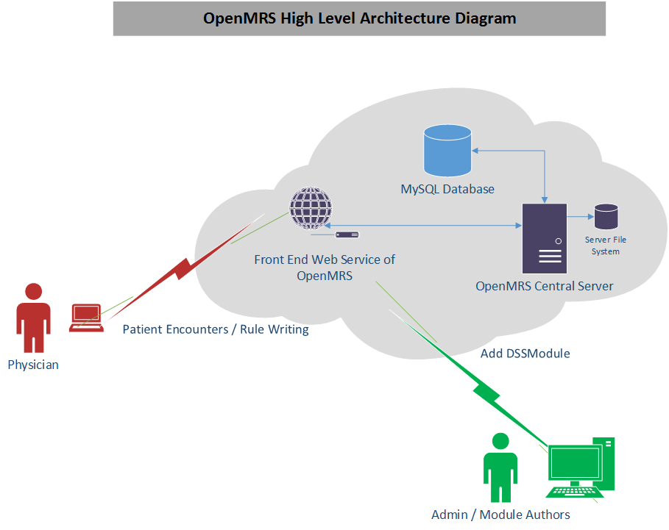
Architecture Use Case Overview

Slide 5
Typical Use Cases
Creating Rules for:
Drug Interactions
Abnormal Test Results
Significant changes in vitals between encounters
Patient reminders

Slide 6
Demo

Slide 7
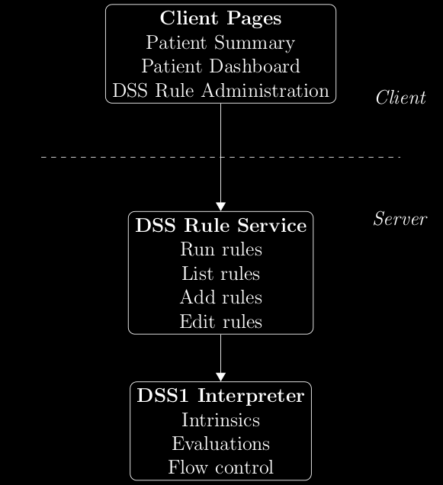
Architecture

Slide 8
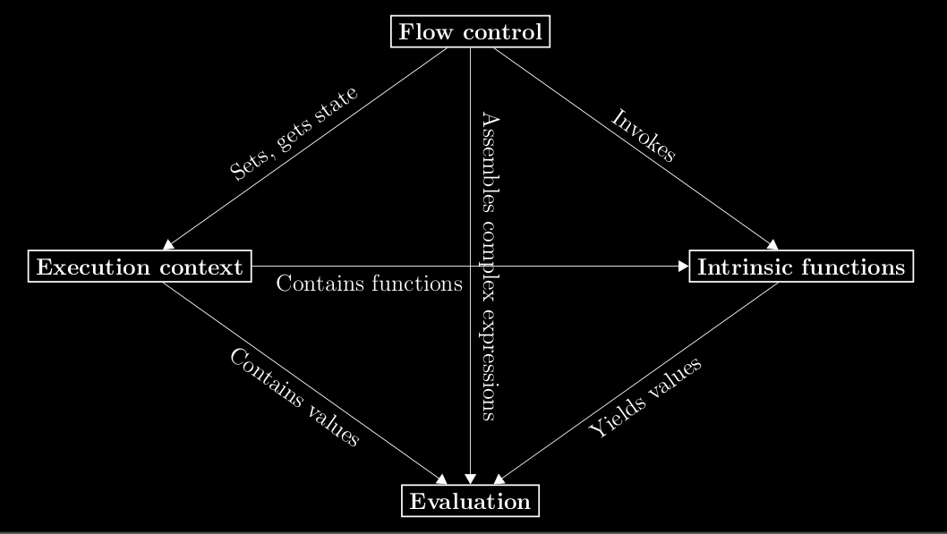
Architecture

Slide 9
Development
We had a diverse set of tools to complete the DSS within OpenMRS
Most work was done in Netbeans
Most coding was in Java (at various levels of sophistication)
Javascript/JSP
XML
Spring Framework
SVN
We also had to deal with and work around (mainly for documentation) each of us having different operating systems

Slide 10
Overcoming Issues
Schedules & Communications
We all had different schedules & Locations
This led to issues with dependencies and communication
We would meet after class
Several times in the Computer Lab (2-3 hours each time)
Communicate via Email
Met over the Web with Web Conferencing

Slide 11
Overcoming Issues
Skills & Teamwork
We had some assumptions in skills including Annotations, UML, JSP, and learning OpenMRS that proved to be in issue in some initial mismatches of assignments
By better matching skills to assignments and cooperative teamwork we were able to maintain a better work flow, have a smother code integration and deal with the dependencies.
Utilizing LaTeX allowed us to more readily integrate our documentation even when submitted near the deadline

Slide 12
Conclusion
The Decision Support System provides a simplified language for allowing rule creation
Rules allow data to be transformed into information
By working together as a team and supporting each other we were able to overcome impediments and complete the project.
Future work on the DSS for openMRS would include the assignment of rules to specific concerns and the management (deleting, disabling, etc.) of rules

Slide 13
Q & A

